Slide 1

Validation of DynaFlow versus Hades
Dynaωo
Training Session: the Design of Compound Scores
February 17, 2022

Slide 2
Magnitudes at play
COMPARING POWERFLOW SOLUTIONS: A REMINDER OF THE MAGNITUDES WE ARE USING
Continuous values:
Voltage magnitude at buses
P, Q flows at branches (lines, transformers, phase-shifters, HV-DC lines)
P, Q injections at buses
Discrete values:
Tap positions
Shunt status (on/off)

Slide 3
Compound scores
THE GOAL:
For each contingency case, obtain a single score to measure the “distance” between the powerflow solutions obtained from simulators A & B, taking into account all those magnitudes mentioned before.
ISSUES TO CONSIDER:
The choice between absolute-error and relative-error, and how this is related to the question of the relative importance of differences depending on the voltage-level where they are found:
If we used relative-error, then we would need to consider “weighting” higher-voltage level values as more important than lower-voltage ones
But then it would be equivalent to just using the absolute errors, and then there’s no need to do that
”Locally-sensitive” norms vs. “Globally-sensitive” norms: a L1 norm will mask big localized differences, while a L-inf norm will only look at the max difference. We may want to see both.
And finally: we’ll need user-selectable weights to combine “apples & oranges”, according to user preferences (e.g., what’s more important to you, voltages, flows, taps … ?)

Slide 4
Design decisions
OUR DECISION:
Issue 1: For these scores, just use absolute errors and forget about relative errors (although we do still show them in some tables, in case one wants to see them).
Issue 2: we define three norms, the first one being “local-diffs—sensitive” and the other two a bit more “global-diffs—sensitive”:
MAX norm: the L-infinity of the vector of differences, i.e., the maximum difference in abs value
MEAN norm: the L1 norm but normalized to account for system size (i.e., dividing the norm by system size N)
“P95” norm: the value of the 95% percentile (interpretation, for instance: “for 95% of the buses, the diffs are below 2.3kV”)
Issue 3: just use some user-selectable weights to combine voltages with MW with taps… etc.

Slide 5
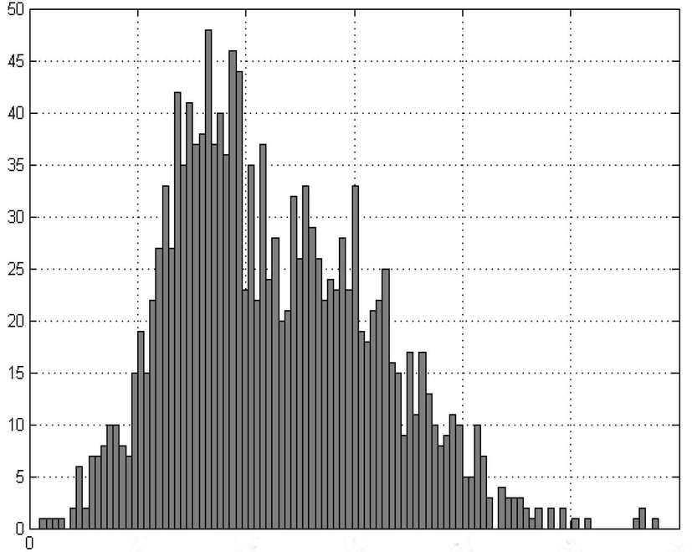
Norms (or, rather, error statistics)
Histogram of the A vs. B errors, for magnitude X
At the end of the day, these three “norms” are nothing but three straightforward statistics for the histogram of (absolute) errors:
The maximum
The mean
The 95% percentile
Number of errors
1
2
3
abs(X_{A} - X_{B})

Slide 6
Compounding norms from different magnitudes
APPLES AND ORANGES PUT TOGETHER VIA USER-SELECTABLE WEIGHTS
It’s useful to think in terms of coefficients that yield a dimensionless number
Examples:
W_v = (1 / 2 kV). → normalizes the abs-error in voltage magnitude; an error of 2kV yields a dimensionless value of 1.
W_p = (1 / 5 MW) → normalizes the abs-error in active power; an error of 5MW yields a dimensionless value of 1.
W_q = (1 / 10 Mvar) → normalizes the abs-error in reactive power; an error of 10Mvar yields a dimensionless value of 1.
W_tap : (1 / 3) → normalizes the weight we want to assign to tap changes; an error of 3 tap positions yields a dimensionless value of 1.
Once we have the weighted sum of all components (voltage, flows, etc.) we have the final score value.

Slide 7
Final step: define thresholds for these compound scores
After gaining some experience with the observed results, we can define some reasonable values for the PASS / NOT_PASS thresholds
In any case, they are user-configurable too.

Slide 8
Final step: define thresholds for these compound scores
Scores of the 25th in the list, in each ranking
(after having removed pathological cases)
-----------------------------------------------
BASECASE = "20220106-1000-enrichi.BASECASE"
MAX_SCORE P95_SCORE MEAN_SCORE
branches: 18.4 0.297 0.0548
gens: 11.4 0.265 0.0308
loads: 8.98 0.185 0.0242
shunts: 10.3 0.166 0.0250
BASECASE = "20210614_2215a.BASECASE"
MAX_SCORE P95_SCORE MEAN_SCORE
branches: 39.6 0.861 0.0573
gens: 40.0 0.704 0.0574
loads: 26.7 0.321 0.0479
shunts: 24.9 0.196 0.0460
BASECASE = "20210422_0930a.BASECASE"
MAX_SCORE P95_SCORE MEAN_SCORE
branches: 26.9 0.889 0.0134
gens: 29.6 0.895 0.00887
loads: 12.3 0.286 0.00795
shunts: 5.46 0.0493 0.00882
Approx. number of contingency cases:
9,000 branch, 7,000 load, 4,000 gen, 140 shunt.
NOTE: results obtained using these default weights:
W_V = 1/2, W_P = 1/5, W_Q = 1/10, W_T = 1/3
DEFAULT VALUES THAT WE PROPOSE, GIVEN THESE RESULTS
MAX_THRESH = 25
P95_THRESH = 0.8
MEAN_THRESH = 0.05
Note that, of course, these values would be influenced by the weights chosen above. If you change them, you’d have to somehow re-scale these.

